Slide 1
OpenGL Tutorial

Slide 2
Some terms:
gl, glx, glu, glut, freeglut, glfw, glm…
gl: GL/gl.h. They are the base OpenGL headers, which give you OpenGL-1.1 function and token declarations
glu: GL/glu.h. This is OpenGL utilities library, which has been not updated for long time. You don't need to use this header file in this semester.
glew: GL/glew.h OpenGL Extension Wrangler Library. This is a cross-platform library for loading OpenGL extended functionality.

Slide 3
Some terms:
glut: OpenGL Utility Toolkit for Windowing API. This is good for small to medium size OpenGL program. If you need more sophisticated windowing libraries, use native window system toolkits like GTK or Qt for linux machines.
glfw: OpenGL Frame Work. Another multi-platform library for creating windows and handling events. FreeGlut can be used as an alternative.
glm: OpenGL Mathematics. It helps implementing vectors and matrices operations.

Slide 4
What we need:
glew
glfw/glut/freeglut
glm (recommended)

Slide 5
Windows:
You can download the compiled binary file directly
GLEW:
http://glew.sourceforge.net/
https://sourceforge.net/projects/glew/files/glew/2.0.0/glew-2.0.0-win32.zip/download
GLFW:
http://www.glfw.org/download.html
https://github.com/glfw/glfw/releases/download/3.2.1/glfw-3.2.1.bin.WIN64.zip
GLM:
https://github.com/g-truc/glm/archive/0.9.8.4.zip

Slide 6
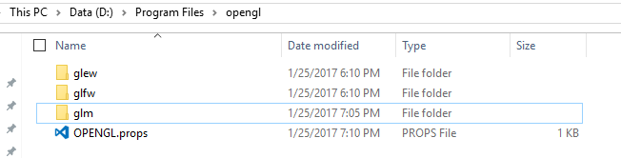
Windows:
Wrap them into a folder named: opengl

Slide 7
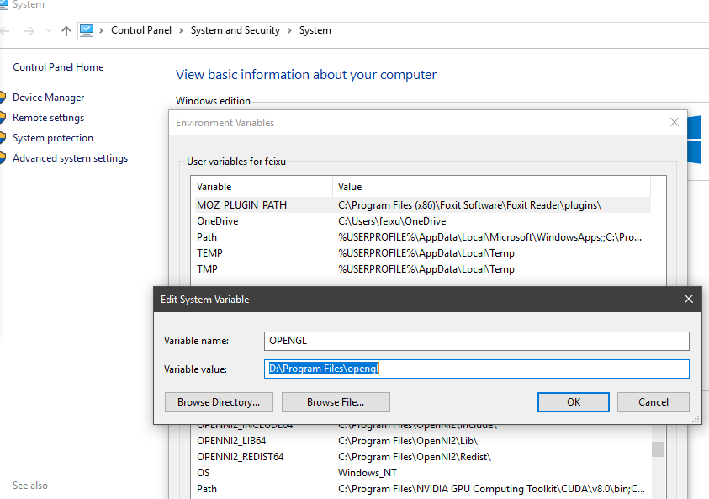
Windows:
Add path

Slide 8
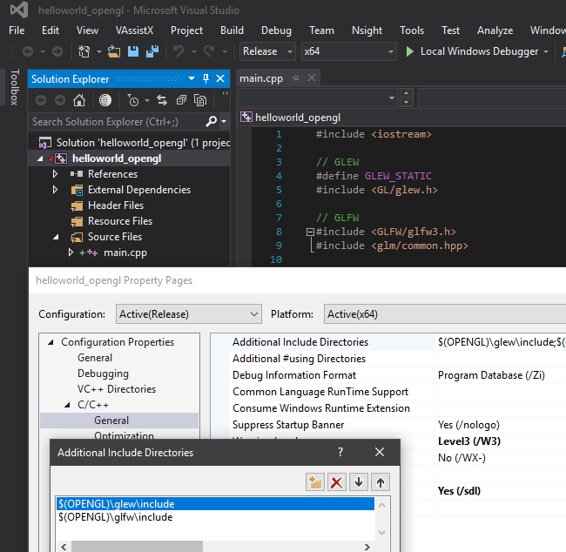
Windows:
Add external libs path and include
path in Property pages
(or import prop page)

Slide 9
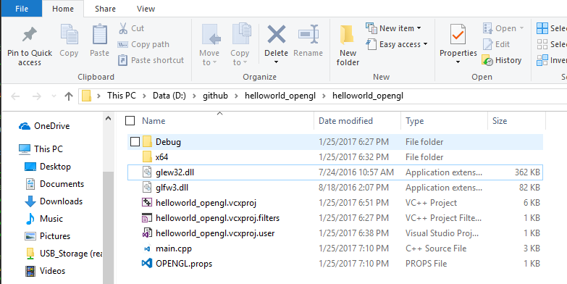
Windows:
Add dll to the folder, type the example OpenGL code in the main.cpp

Slide 10
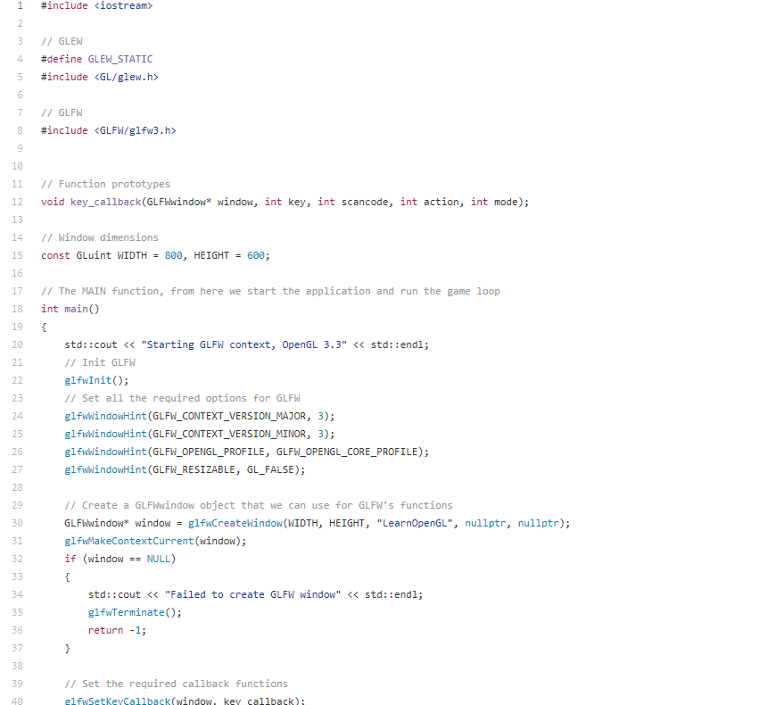
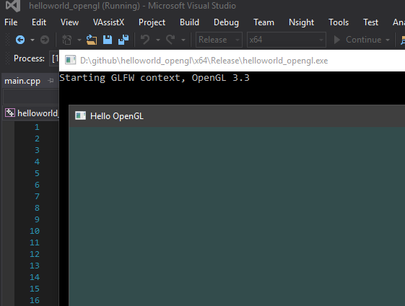
Windows:
Main.cpp
https://github.com/JoeyDeVries/LearnOpenGL/blob/master/sr
c/1.getting_started/1.hello_window/hellowindow2.cpp

Slide 11
Mac:
Homebrew:
$ brew update
$ brew install glfw3 glew
XCode
Add /usr/local/include in header path
Add /usr/local/glew/2.0.0/lib /usr/local/Cellar/glfw/3.2.1/lib in library path
Add link binary libraries
libglfw.3.2.dylib libGLEW.2.0.0.dylib OpenGL framework
(If you are facing the “GLFW Fails to Open Window in OSX error”(This is one error I face during compilation), add glfwWindowHint(GLFW_OPENGL_FORWARD_COMPAT, GL_TRUE);)
(http://stackoverflow.com/questions/22887922/glfw-fails-to-open-window-in-osx)

Slide 12
Linux:
● $ sudo apt-get install libglew-dev libglfw3-dev libglm-dev
● $ sudo g++ -o helloworld helloworld.cpp -std=c++11 -lGL -lglfw -lGLEW

Slide 13
GUI
NanoGUI
https://github.com/wjakob/nanogui
AntTweakBar
http://anttweakbar.sourceforge.net/doc/

Slide 14
Some useful links
Mac:
https://www.youtube.com/watch?v=4zjCqjfjcPs
Windows:
https://www.youtube.com/watch?v=mGC4T9AG4nc&t=533s
Some good tutorial:
Red book never goes wrong
https://learnopengl.com/
http://www.lighthouse3d.com/

Slide 15
GLSL Shader Programming

Slide 16
Introduction
How to implement all those functions in OpenGL?
Input: Models(obj file)/Parameters(colors,positions)
Output: Rendered image

Slide 17
Rendering Pipeline
What is rendering pipeline?
Why we need rendering pipeline?
How to program under rendering pipeline (Here we use OpenGL)

Slide 18
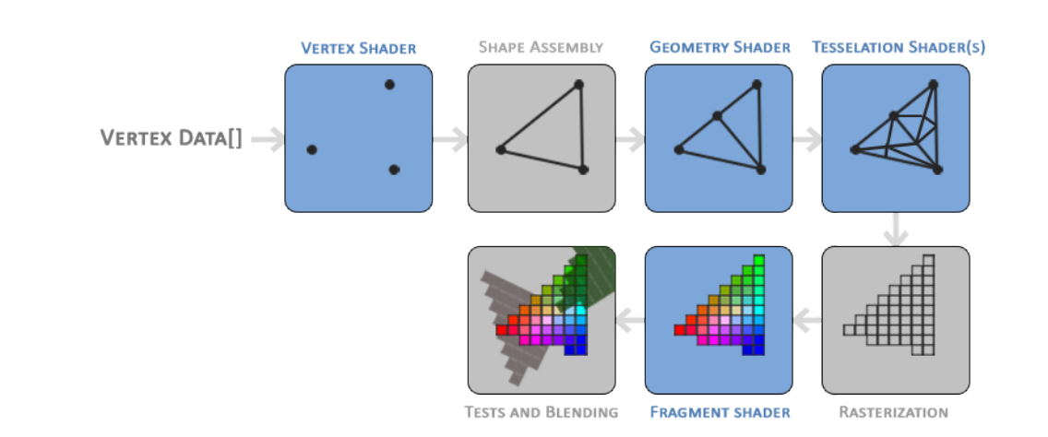
Rendering Pipeline(What?)

Slide 19
Rendering Pipeline(Why?)
(Shader based pipeline - new)
GLfloat vertices[] = {
0.5f, 0.5f, 0.0f,
0.5f, -0.5f, 0.0f,
-0.5f, -0.5f, 0.0f,
-0.5f, 0.5f, 0.0f};
GLuint indices[] = {0, 1, 3,
1, 2, 3};
GLuint VBO, VAO, EBO;
glGenVertexArrays(1, &VAO);
glGenBuffers(1, &VBO);
glGenBuffers(1, &EBO);
glBindVertexArray(VAO);
glBindBuffer(GL_ARRAY_BUFFER, VBO);
glBufferData(GL_ARRAY_BUFFER, sizeof(vertices), vertices, GL_STATIC_DRAW);
glBindBuffer(GL_ELEMENT_ARRAY_BUFFER, EBO);
glBufferData(GL_ELEMENT_ARRAY_BUFFER, sizeof(indices), indices, GL_STATIC_DRAW);
glVertexAttribPointer(0, 3, GL_FLOAT, GL_FALSE, 3 * sizeof(GLfloat), (GLvoid*)0);
glEnableVertexAttribArray(0);
glBindBuffer(GL_ARRAY_BUFFER, 0);
glBindVertexArray(0);
glBindVertexArray(VAO);
//glDrawArrays(GL_TRIANGLES, 0, 6);
glDrawElements(GL_TRIANGLES, 6, GL_UNSIGNED_INT, 0);
glBindVertexArray(0);
(Fixed Pipeline - old)
glLoadIdentity();
glTranslatef(1.5f,0.0f,-6.0f);
glRotatef(rquad,1.0f,0.0f,0.0f);
glBegin(GL_POLYGON);
glColor3f(1.0f,0.0f,0.0f);
glVertex3f( 0.0f, 1.0f, 0.0f);
glColor3f(0.0f,1.0f,0.0f);
glVertex3f(-1.0f,-1.0f, 0.0f);
glColor3f(0.0f,0.0f,1.0f);
glVertex3f( 1.0f,-1.0f, 0.0f);
glEnd();
Why we still have to use the shader based pipeline?

Slide 20
Rendering Pipeline(Why?)
The rendering pipeline is mapped onto current graphics acceleration hardware such that the input to the GPU is in the form of vertices
The graphics pipeline is well suited to the rendering process because it allows the GPU to function as a stream processor since all vertices and fragments can be thought of as independent.
Their independence allows graphics processors to use parallel processing units to process multiple vertices or fragments in a single stage of the pipeline at the same time.

Slide 21
Rendering Pipeline(How?)
Some important terms:
VAO (vertex based object)
VBO (buffer based object)
Shader (vertex shader/fragment shader)
Vertex attribute pointer

Slide 22
Vertex Buffer Object (VBO)
The address to store a large number of vertices in the GPU's memory.
GLfloat vertices[] = { -0.5f, -0.5f, 0.0f, 0.5f, -0.5f, 0.0f, 0.0f, 0.5f, 0.0f };
GLuint VBO;
glGenBuffers(1, &VBO); // Generate VBO
glBindBuffer(GL_ARRAY_BUFFER, VBO); // Activate VBO as “ARRAY BUFFER”
glBufferData(GL_ARRAY_BUFFER, sizeof(vertices), vertices, GL_STATIC_DRAW); // Send some parameters to VBO
void glBufferData( | GLenum target,
 | GLsizeiptr size,
 | const GLvoid * data,
 | GLenum usage);

Slide 23
Vertex Array Object (VAO)
Object that describes how the vertex attributes are stored in a Vertex Buffer Object (or VBO). This means that the VAO is not the actual object storing the vertex data, but the descriptor of the vertex data.
GLuint vao;
glGenVertexArrays(1, &vao); // Generate VAO
glBindVertexArray(vao); // Bind VAO
…….. // Descriptor of the vertex data
glBindVertexArray(0); // UnBind VAO

Slide 24
Vertex Attribute Pointer
Specify how OpenGL should interpret the vertex data before rendering.
glVertexAttribPointer(0, 3, GL_FLOAT, GL_FALSE, 3 * sizeof(GLfloat), (GLvoid*)0);
// Initialize attribute pointer corresponding to VAO(with parameter)
glEnableVertexAttribArray(0);
// Enable attribute pointer

Slide 25
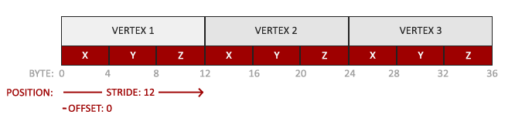
Vertex Attribute Pointer
void glVertexAttribPointer( | GLuint index,
 | GLint size,
 | GLenum type,
 | GLboolean normalized,
 | GLsizei stride,
 | const GLvoid * offset);
glVertexAttribPointer(0, 3, GL_FLOAT, GL_FALSE, 3 * sizeof(GLfloat), (GLvoid*)0);

Slide 26
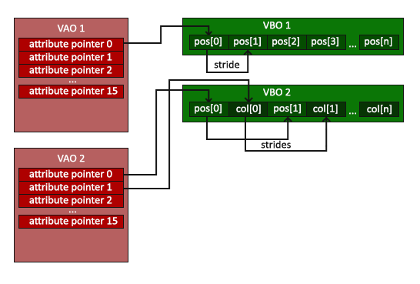
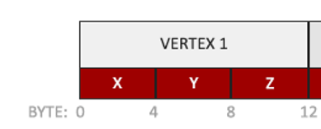
Relation between VAO/VBO/Attribute Pointer

Slide 27
All together in VAO
GLfloat vertices[] = {
// Position //Normal
0.5f, -0.5f, 0.0f, 1.0f, 0.0f, 0.0f,
-0.5f, -0.5f, 0.0f, 0.0f, 1.0f, 0.0f
0.0f, 0.5f, 0.0f, 0.0f, 0.0f, 1.0f};
GLuint vbo, vao;
glGenVertexArrays(1, &vao);
glGenBuffers(1, &vbo);
glBindVertexArray(vao);
// Bind vbo and bind vbo_data
glBindBuffer(GL_ARRAY_BUFFER, vbo);
glBufferData(GL_ARRAY_BUFFER, sizeof(vertices), vertices, GL_STATIC_DRAW);
// Bind two vao pointer
glVertexAttribPointer(0, 3, GL_FLOAT, GL_FALSE, 6 * sizeof(GLfloat), (GLvoid *)0);
glEnableVertexAttribArray(0);
glVertexAttribPointer(1, 3, GL_FLOAT, GL_FALSE, 6 * sizeof(GLfloat), (GLvoid*)(3 * sizeof(GLfloat)));
glEnableVertexAttribArray(1);
glBindVertexArray(0);

Slide 28
All together in VAO
Input:
Models
Output:
GLuint VAO;
On rendering, or whenever the object is used:
Bind it to make it current.
Use it.
Unbind it.

Slide 29
Shader
"a program that tells a computer how to draw something in a specific and unique way.“
Calculating how a 3D object should look, taking lighting into account
Small C-like programs executed on the graphics-hardware
Shader Type:
Vertex Shader
Fragment Shader

Slide 30
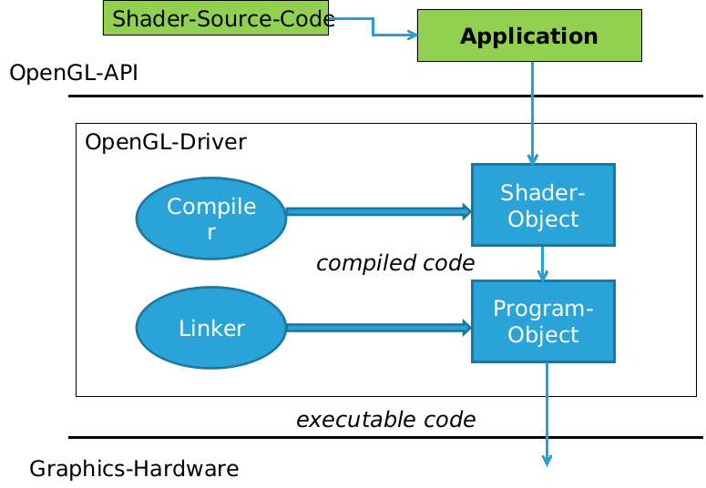
Shader

Slide 31
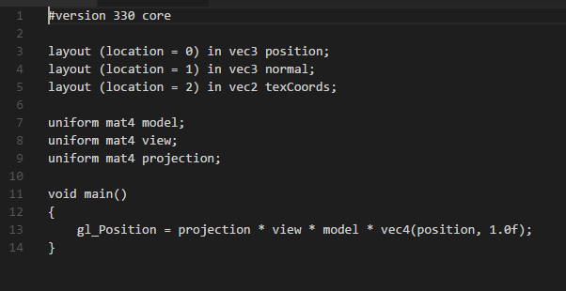
Vertex Shader
The Vertex Shader is the programmable Shader stage in the rendering pipeline that handles the processing of individual vertices.
Simple Vertex Shader

Slide 32
Vertex Shader
How to relate the shader program with main program?
Send to main program using char*(You can use ifstream to read from file as well)
const GLchar* vertexShaderSource = "#version 330 core\n"
"layout (location = 0) in vec3 position;\n"
"void main()\n"
"{\n"
"gl_Position = vec4(position.x, position.y, position.z, 1.0);\n"
"}\0";

Slide 33
Vertex Shader
Compiling shader program
GLchar* vertexShaderSource = “……….”
GLuint vertexShader;
vertexShader = glCreateShader(GL_VERTEX_SHADER); // Create Shader
glShaderSource(vertexShader, 1, &vertexShaderSource, NULL);// Bind Shader glCompileShader(vertexShader); // Compile Shader

Slide 34
Vertex Shader
Debug(it can alse been used later):
No printf in shader code
GLint success;
GLchar info_log[1024]
glGetShaderiv(shader, GL_COMPILE_STATUS, &success);
if (!success) {
glGetShaderInfoLog(shader, 1024, NULL, info_log);
std::cout << "| Error:: "|\n" << info_log << "\n";
}

Slide 35
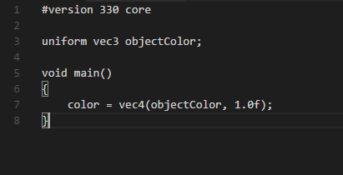
Fragment Shader
A Fragment Shader is the Shader stage that will process a Fragment generated by the Rasterization into a set of colors and a single depth value. The fragment shader is the OpenGL pipeline stage after a primitive is rasterized.
Simple fragment shader

Slide 36
Fragment Shader
Compiling shader program
GLchar* fragmentShaderSource = “……….”
GLuint fragmentShader;
fragmentShader = glCreateShader(GL_FRAGMENT_SHADER); glShaderSource(fragmentShader, 1, &fragmentShaderSource, NULL); glCompileShader(fragmentShader);

Slide 37
Shader
Combine two together, link to a program and use program in rendering
GLuint shaderProgram;
shaderProgram = glCreateProgram(); // Create Shader Program
glAttachShader(shaderProgram, vertexShader); // Attach vertex shader
glAttachShader(shaderProgram, fragmentShader); // Attach fragment shader glLinkProgram(shaderProgram); // Link to ShaderProgram
While(windows){
glUseProgram(shaderProgram); // Use ShaderProgram during rendering
}

Slide 38
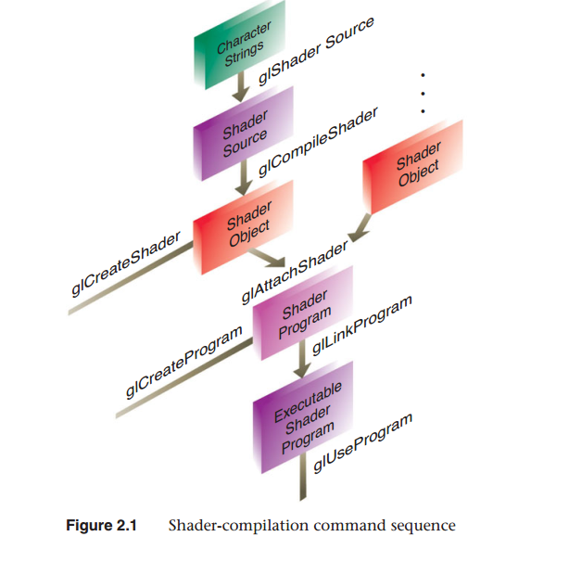
Shader Pipeline

Slide 39
GLSL Shader Syntax
Built-In Types
GLSL has some built-in attributes in a vertex shader:
gl_Position: output position from vertex shader
gl_FragColor: output color from fragment shader
Only for ES, WebGL and older versions of GLSL
Present version use an out variable

Slide 40
GLSL Shader Syntax
Data Types
There are four main types: float, int, bool and sampler. For the first three types, vector types are available:
vec2, vec3, vec4 2D, 3D and 4D floating point vector
ivec2, ivec3, ivec4 2D, 3D and 4D integer vector
bvec2, bvec3, bvec4 2D, 3D and 4D boolean vectors
For floats here are also matrix types:
mat2, mat3, mat4 2x2, 3x3, 4x4 floating point matrix
Samplers are types representing textures. They are used for texture sampling. Sampler types have to be uniform. They are not allowed to be declared as a non-uniform type. Here are the different sampler types:
sampler1D, sampler2D, sampler3D 1D, 2D and 3D texture
samplerCube Cube Map texture
sampler1Dshadow, sampler2Dshadow 1D and 2D depth-component texture

Slide 41
GLSL Shader Syntax
Swizzling
You can access the components of vectors using the following syntax:
vec2 someVec;
vec4 otherVec = someVec.xyxx;
vec3 thirdVec = otherVec.zyy;
vec4 someVec;
someVec.wzyx = vec4(1.0, 2.0, 3.0, 4.0);
someVec.zx = vec2(3.0, 5.0);

Slide 42
GLSL Shader Syntax
Storage quantifier
const
read-only. const float pi = 3.1415926
in
VS: input changes per vertex, read-only
in vec2 tex_coord;
out
Copy vertex attributes and other variables from shaders
Shader-output; VS to FS; FS output
out vec4 color;
uniform: variable from application, does not change per primitives; read only in shader
uniform float time;
uniform vec4 rotation;

Slide 43
GLSL Shader Syntax
Built in functions
Arithmetic: sqrt, pow, abs, log, log2, exp, min, max, clamp
Trigonometric: sin, asin, tan
Angles are measured in radian
Works on vectors component-wise
vec3 angles;
vec3 vs = sin(angles);
Graphical: length, reflect, dot, cross, distance
vec3 l,n;
float f = length(l); // vector length
Vec3 r = reflect(-l,n), given l and n, find r.
What’s wrong ?
vec3 n = // ...
normalize(n); // normalize() returns a new vector

Slide 44
Shader Example
layout (location = 0) in vec3 position;
// Hint: glVertexAttribPointer(0, 3, GL_FLOAT, GL_FALSE, 6 * sizeof(GLfloat), (GLvoid *)0);
layout (location = 1) in vec3 normal;
// glVertexAttribPointer(1, 3, GL_FLOAT, GL_FALSE, 6 * sizeof(GLfloat), (GLvoid*)(3 * sizeof(GLfloat)));
uniform mat4 model;
// GLint modelLoc = glGetUniformLocation(lightingShader.program, "model");
// glUniformMatrix4fv(modelLoc, 1, GL_FALSE, glm::value_ptr(model));
uniform mat4 view;
uniform mat4 projection;
void main(){
gl_Position = projection * view * model * vec4(position.xyz, 1.0f);
}

Slide 45
Resources
OpenGL “Red Book“
OpenGL “Orange Book“
LearnOpengl, http://www.learnopengl.com
LightHouse 3D, http://www.lighthouse3d.com/opengl/
OpenGL Wiki

